Slide 1
Introduction to Computational Journalism
JOUR479V/779V – Computational Journalism
University of Maryland, College Park
Nick Diakopoulos, Ph.D.

Slide 2
Introductions
Name
Program & Year
Interest in taking this class & What you hope to learn

Slide 3
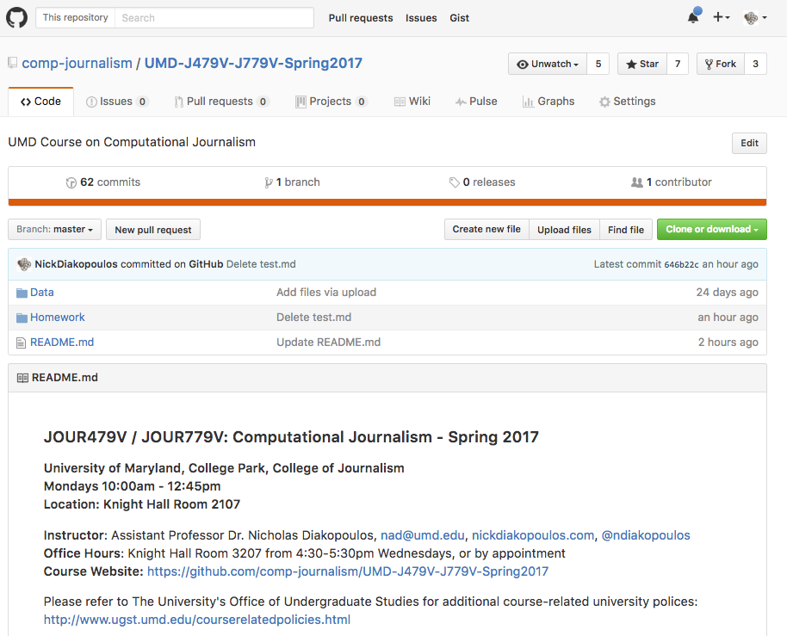
https://github.com/comp-journalism/UMD-J479V-J779V-Spring2017
Notes:
It’s on Github: https://github.com/comp-journalism/UMD-J479V-J779V-Spring2017

Slide 4
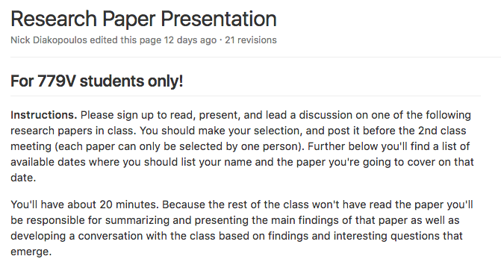
Research Paper Presentations

Slide 5
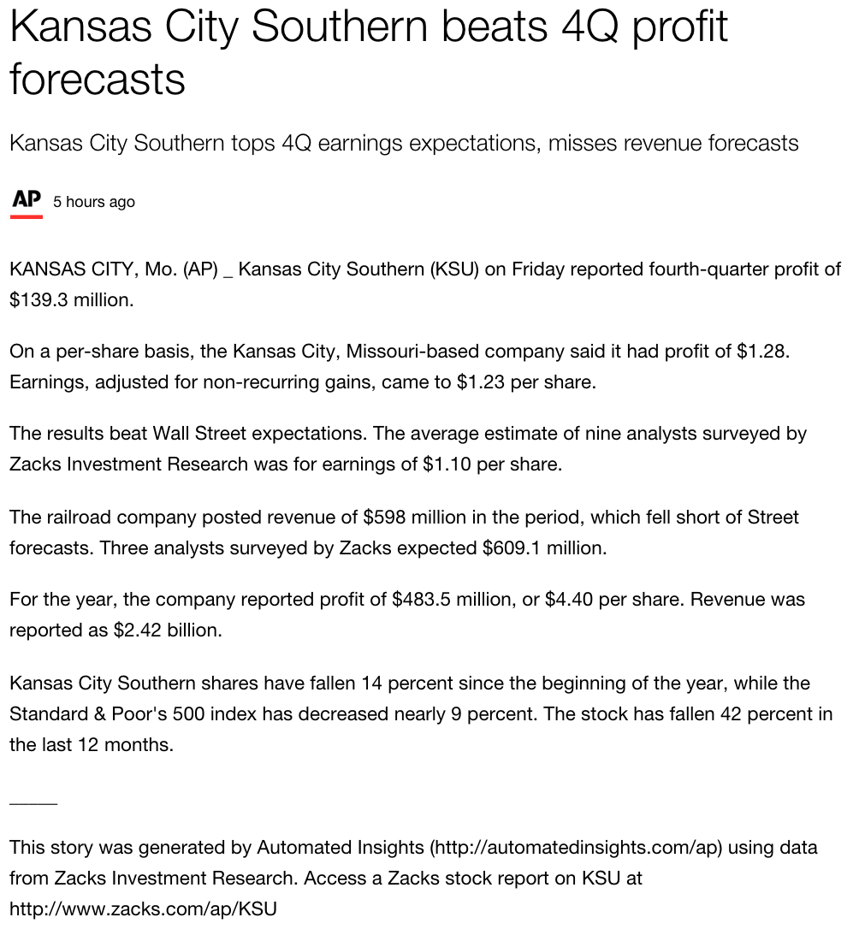
Automated Insights
Notes:
http://finance.yahoo.com/news/kansas-city-southern-beats-4q-131940853.html
This is an example of an article that was generated automatically by a piece of software from Automated Insights. This software is in use and generates thousands of earnings reports every fiscal quarter for the associated press. In this class we’ll learn about how automation is used to created / write text articles and other forms of content.

Slide 6
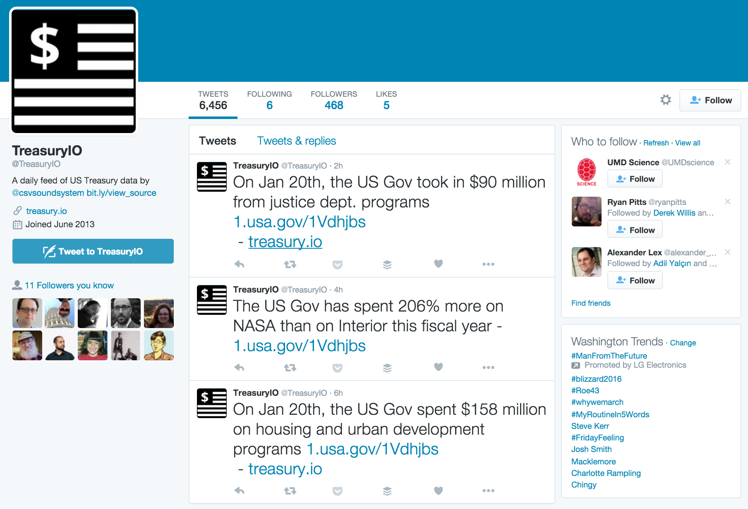
Notes:
Another type of automation that we’ll discuss in class are online bots. TreasuryIO is a bot that summarizes US treasury spending every day and then synthesizes written tweets about those numbers periodically. What else could you automated with a bot?

Slide 7
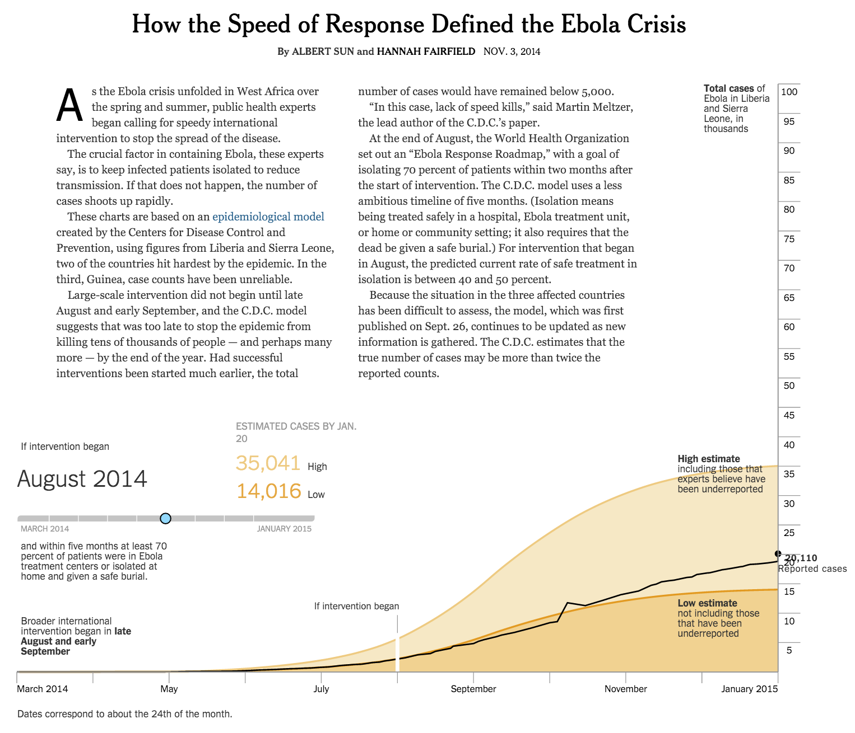
Notes:
http://www.nytimes.com/interactive/2014/11/04/health/visuals-ebola-model.html?_r=0
Another way that computing is used in the news is to create models, simulations, or predictions. We’ll talk about simulation / modeling in the context of storytelling. In this example a model was used to tell the story of how timing of the international response to the Ebola crisis would have effected the number of cases reported.

Slide 8
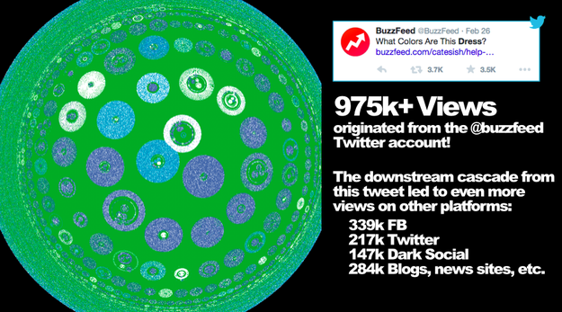
Buzzfeed Pound
Notes:
http://www.buzzfeed.com/daozers/introducing-pound-process-for-optimizing-and-understanding-n#.axyqwmb0n
Pound is a new, proprietary technology that captures how BuzzFeed stories spread on the social web. It follows propagations from one sharer to another, through all the downstream visits, even across social networks and one-to-one sharing platforms like Gchat and email. Pound is the Process for Optimizing and Understanding Network Diffusion.
We’ll talk about social media and content analytics and how it’s changing the dissemination and optimization of media. So not only is computing used for storytelling, but it can also be used to create data-driven products or platforms than optimize and enhance the content that news organizations are producing.

Slide 9
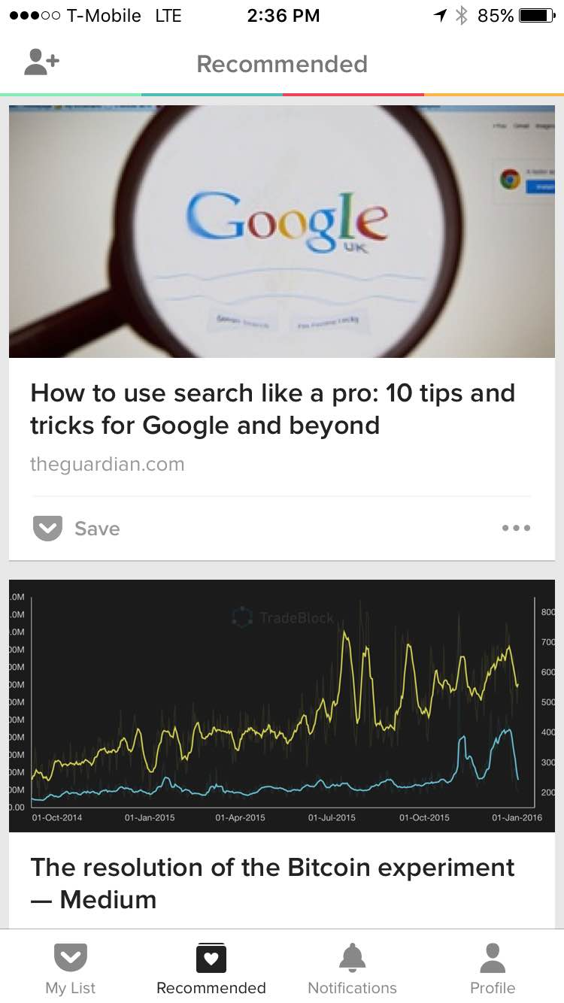

Notes:
Pocket or NYT Recommended is just example of a content curation algorithm in place. We also see these in places like FB, Flipboard, or SmartNews, or in tools like comment moderation, not to mention social listening tools that help journalists find interesting UGC for reporting purposes. Algorithms are embedded in these tools to help deal with scale and help either end-users or journalists themselves sift through the huge volume of content out there to find the stuff that’s relevant and interesting.

Slide 10
Computational Journalism
Finding and telling news stories, with, by, or about algorithms.
Praxis about integrating data, modeling, simulation, programming into journalistic norms, goals, and epistemology
Notes:
So there you have a few examples of computational journalism, but you may still be asking how exactly we define it.
Computational Journalism was initially conceived of as an application of computing technologies to enable journalism across information tasks such as information gathering, organization and sensemaking, storytelling, and dissemination.
It defines an algorithmic approach to the processes of journalism including collecting, organizing, making sense of, communicating, and disseminating news information while upholding the values of journalism such as fairness, accuracy, and transparency.
The praxis aspect deals with integrating notion of “Computational Thinking” into journalistic practice

Slide 11
Computational Journalism
Platforms vs. Stories
Multiple stories, places for exploration, exploit scalability of code
Computable Models
Descriptive abstractions of the world which define associations or rules and allow for prediction or simulation
Computational Thinking
Problem solving via abstraction, algorithms, programming, scale
Notes:
There are other dimensions that also help define how computational journalism extends traditional journalism. For instance, although computing can help find and tell stories, it can also be used to build platforms that in turn support the finding and telling of multiple stories.
A key element of computational journalism is the use of models, or simplified descriptions of the world. Another important aspect is the notion of computational thinking which will talk about more next.

Slide 12
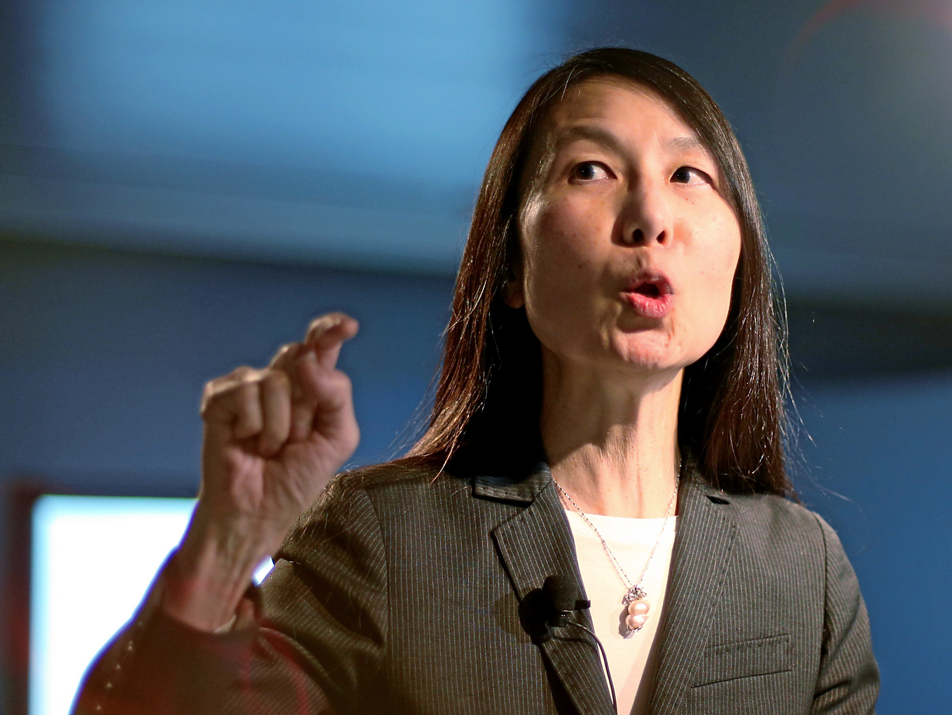
“The thought processes involved in formulating problems and their solutions so that the solutions are represented in a form that can be effectively carried out by an information-processing agent.”
– Jeannette Wing, Corporate VP Microsoft Research
Notes:
Jeannette Wing is an important figure when it comes to the idea of computational thinking. This is how she defines it.

Slide 13
Computational Thinking
Is NOT about thinking like a computer
It’s about thinking in a way so that you can USE a computer in the best way possible to solve a problem

Slide 14
Computational Thinking
Abstraction
Algorithms, modeling, decomposition, parameterization
Scale
Less about one story, more about 10, 100, or 1000
Not programming per se
But communicating with the computer to reify algorithms, models, etc. is important nonetheless
Notes:
Computational thinking is really about abstraction. Being able to see a specific problem and recognize that it’s part of a more abstract and general problem. This is what allows us to encode that problem for a computer so that it can be solved over and over again using an algorithm. This enables SCALE, which is the benefit of computing.
CT is not explicitly about programming, though we will learn programming in this course as a way to practice communicating our computational thinking in a way that computers can act on it.

Slide 15
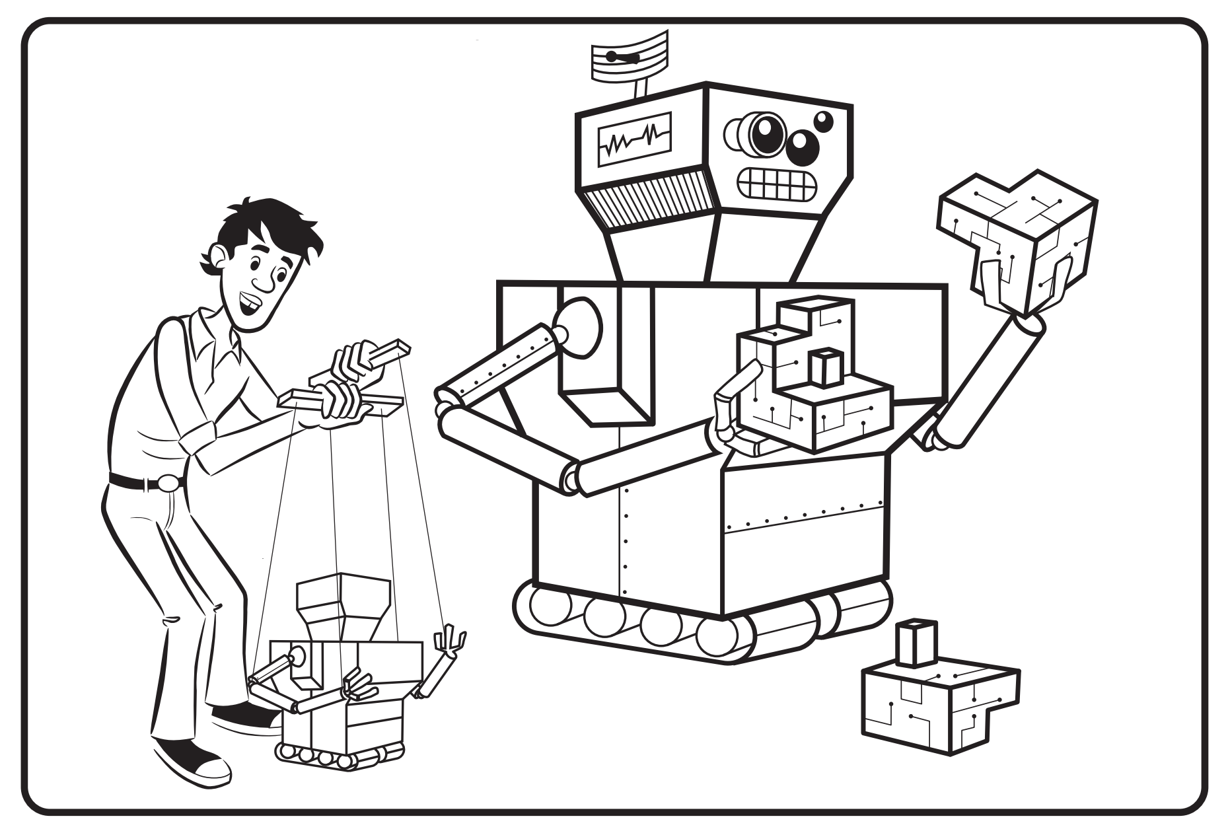
Abstraction / Modeling
Notes:
Modeling is important because it allows us to represent information in a computer system. You can think of modeling as an editorial process because you have to systematically think through what’s included / excluded and highlighted by a model of the world.
For instance in a weather model you can’t represent every molecule of atmosphere in the computer’s memory because that would take up way too much memory! So we simplify and make assumptions that make our models tractable (i.e. solvable) by the computer.
Abstraction lets us recombine models in different ways. When we deliberately separate our system into parts that can be individually understood, tested, reused, and substituted, then we are creating new abstractions.

Slide 16
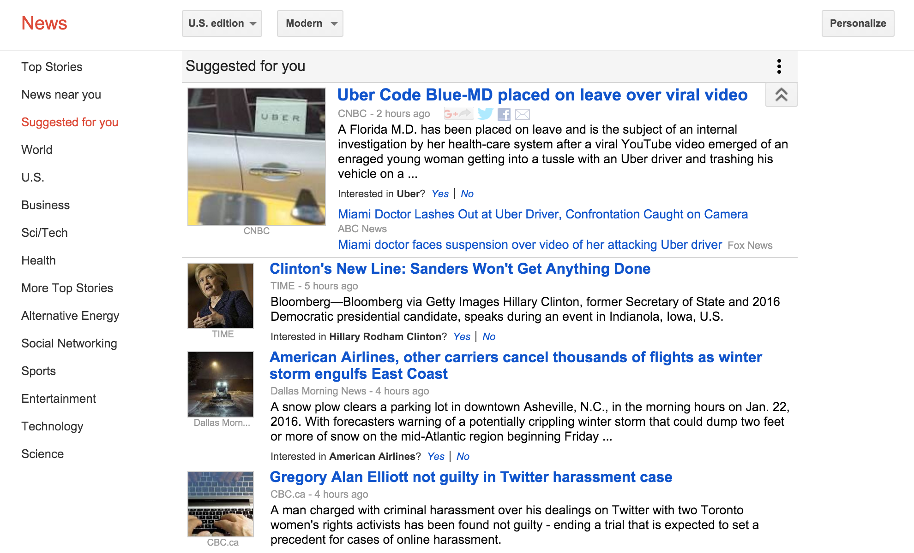
What might abstractions be in the user model that drives Google News personalization?
Notes:
Take for instance a news site like Google News which uses personalization to recommend articles to the user.
Abstractions in model could be things like demographics (age, sex), interests, location, previously browsed news items or sites. But this is just a MODEL of a user! People are much more complex.
Nonetheless this user model allows google to personalize not only your news, but also also your search results, and other services that google may want to personalize, like the ads you’re shown. So by using a model of the user they can personalize not just news but many other things as well.

Slide 17
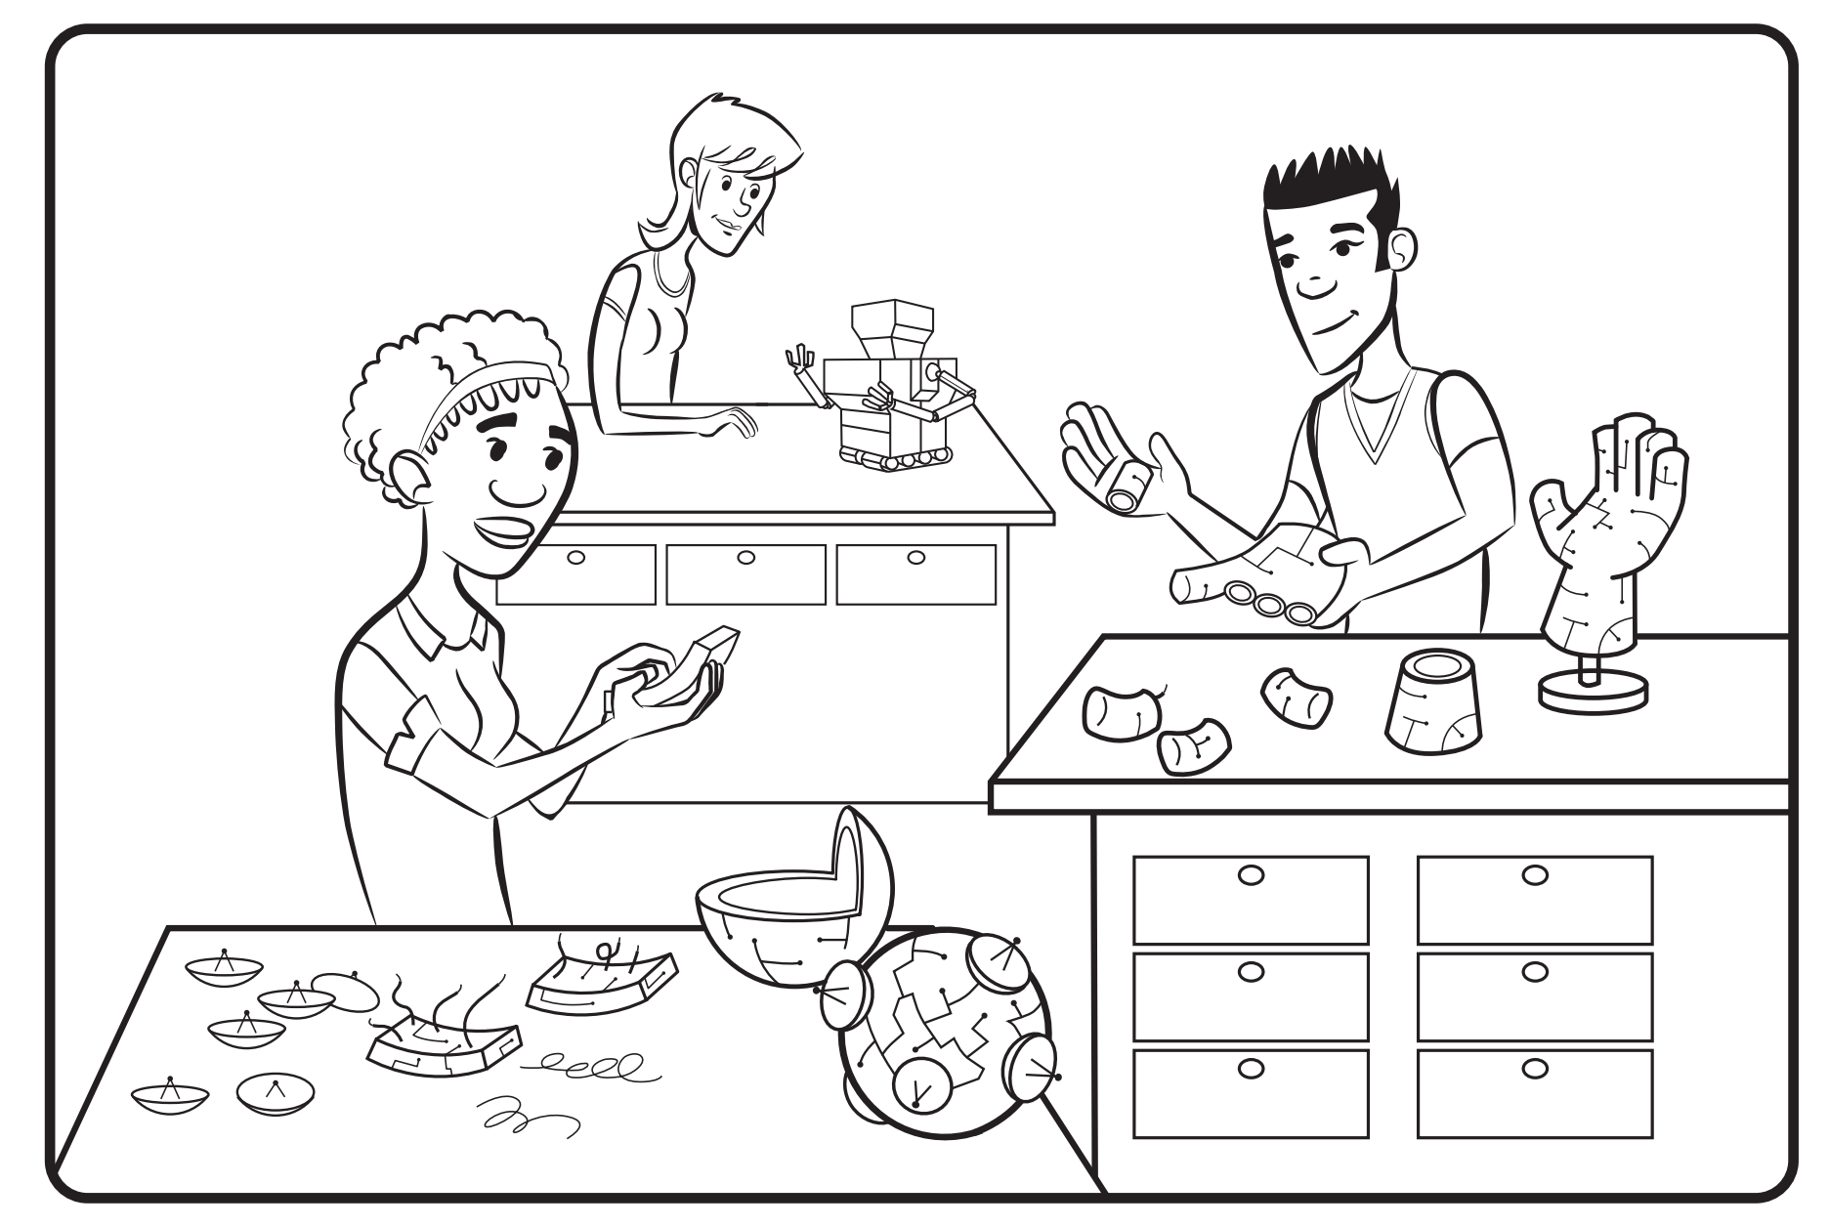
Decomposition
Notes:
Decomposition is about pulling apart the steps of a process. Some things that we think of as a single action are actually a composite of many smaller actions.
If you can break up a big complex task into smaller simpler tasks, some of those simpler / smaller tasks might be solved by a computer, thus subtracting that sub-step from the human effort involved. Other sub-tasks may still need human attention and can’t be automated, but by dis-aggregating and decomposing you allow each (i.e. humans or computers) do what they do best, and then recombine those steps to solve the larger problem.

Slide 18
What might be the sub tasks this bot undertakes to generate a tweet?
Notes:
So back to the treasuryIO example, what might be the subtasks in its operation of transforming data into written tweets?

Slide 19
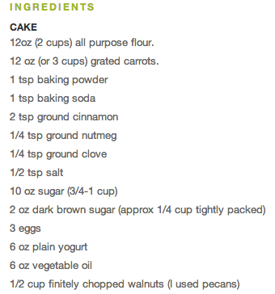
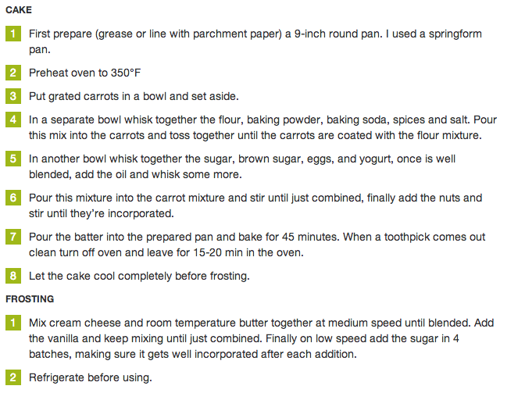

Algorithms & Parameters
Notes:
Algorithms are sequences of steps that can be used to solve the sub problems that you’ve identified as part of a larger task. For the most part we’re interested in algorithms that computers can undertake because that means we can scale them up, but algorithms can also be useful for structuring human work.
If you can come up with an algorithm for solving a problem or making a decision, you can automate it, and automation is cool because it lets you SCALE.
Parameters allow a general / abstract algorithm apply to many different specific cases. Let’s suppose we wanted to make this cake for someone with a vegan diet. What ingredients would we substitute? E.g. Eggs→ Ground Flax Meal | Applesauce and Yogurt → Silken Tofu. So, by providing different parameters to our carrot cake recipe we can also use our algorithm to produce a Vegan cake. The same recipe holds just with some substitutions of different parameters.

Slide 20
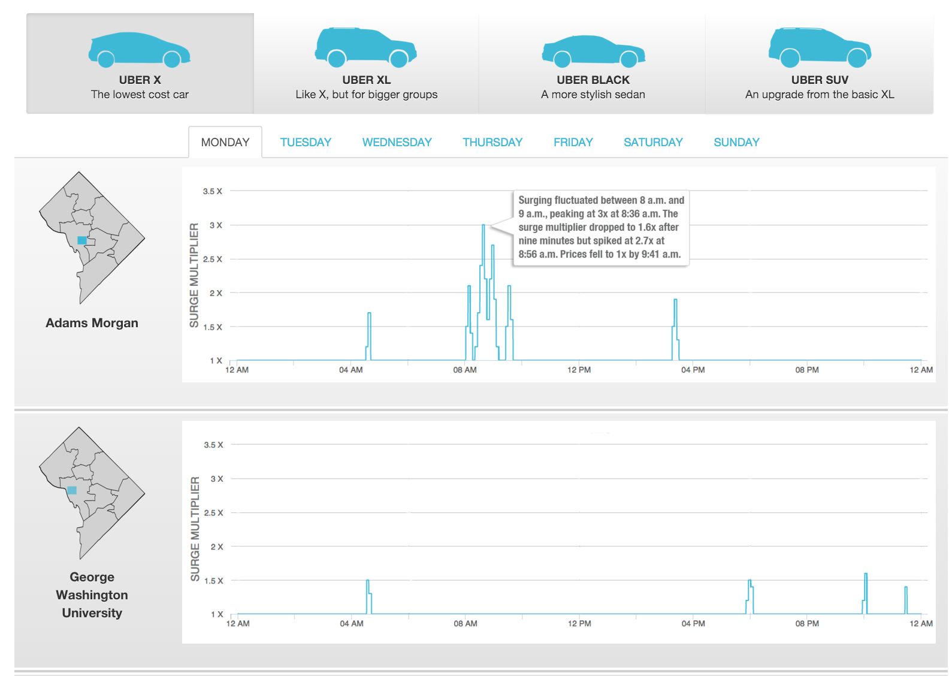
Notes:
http://cnsmaryland.org/interactives/uber/
So for this project we had to generate 140 different graphs to show how Uber prices changed.

Slide 21
Uber Charts
We have 140 charts to generate! And we don’t want to generate each graph by hand.
Let’s say we have an abstraction called GenerateGraph that has an algorithm that will produce the charts we need. What parameters should we build into that abstraction to create all the varieties of graphs needed?
Notes:
The parameters you need to consider are: car type, location, and day of the week. Using those options we could generate each of the 140 different charts based on the abstract GenerateGraph algorithm.

Slide 22
Break

Slide 23

http://www.buzzfeed.com/heidiblake/the-tennis-racket
Notes:
http://www.buzzfeed.com/heidiblake/the-tennis-racket
Here’s an interesting and recent piece of computational journalism which looks at trying to identify tennis players that may have intentionally thrown a match (i.e. fixed the match) in order to get a big payoff.
It included Original Analysis (data, programming, simulation) as well as Evidence linked and highlighted in documents hosted on document cloud which is a platform for hosting documents that’s used by many data journalists.

Slide 24
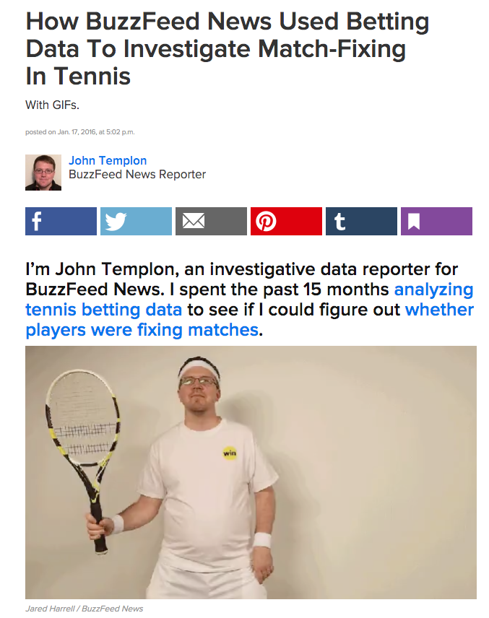
http://www.buzzfeed.com/johntemplon/how-we-used-data-to-investigate-match-fixing-in-tennis#.fozp5P0Jr
Notes:
The piece has a helpful accessible methodology description.

Slide 25
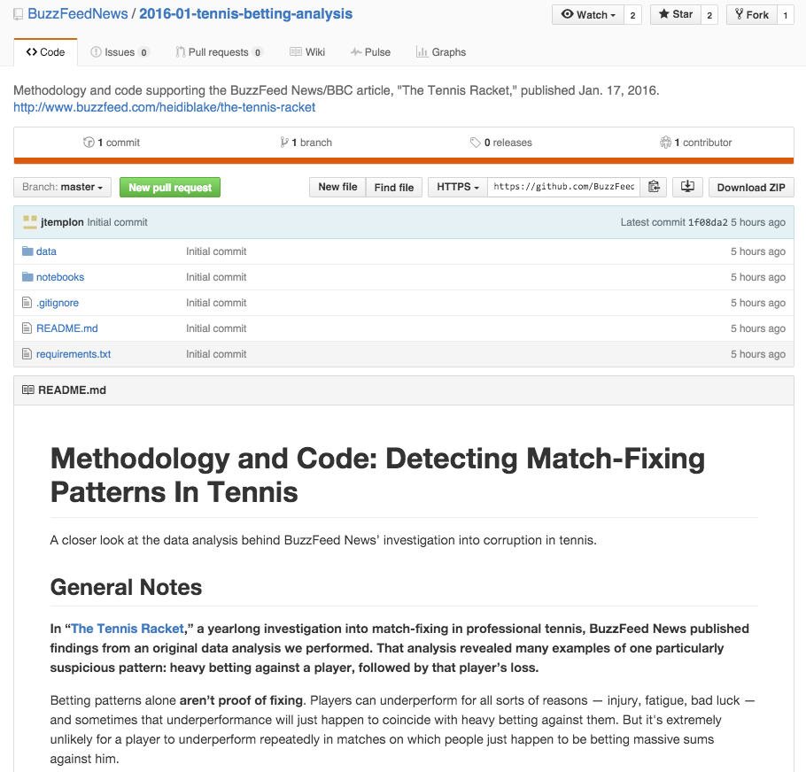
https://github.com/BuzzFeedNews/2016-01-tennis-betting-analysis
Notes:
https://github.com/BuzzFeedNews/2016-01-tennis-betting-analysis
Idea of telescoping transparency … here is the next layer of transparency, which presents the methodology in a little bit more technical terminology. Could you reproduce Buzzfeed’s analysis from just this?

Slide 26
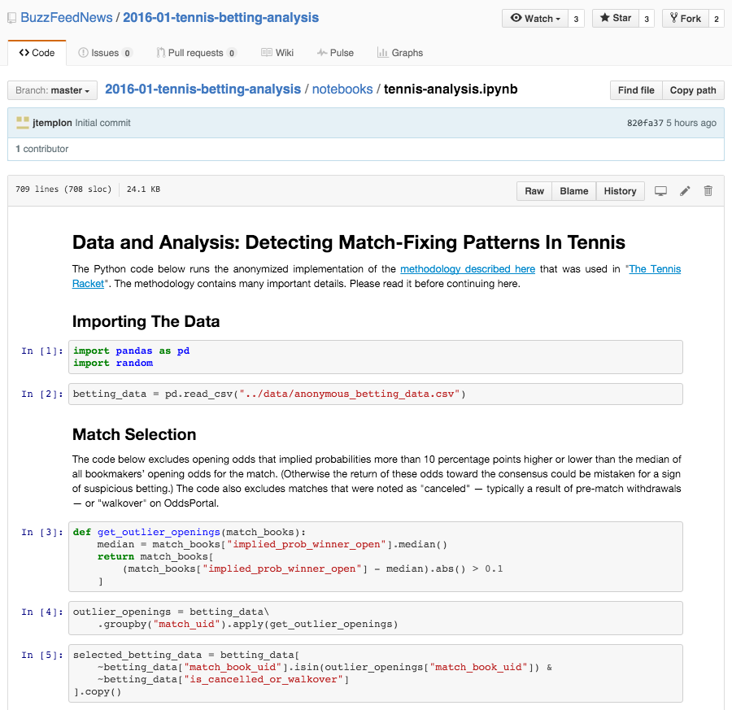
https://github.com/BuzzFeedNews/2016-01-tennis-betting-analysis/blob/master/notebooks/tennis-analysis.ipynb
Notes:
https://github.com/BuzzFeedNews/2016-01-tennis-betting-analysis/blob/master/notebooks/tennis-analysis.ipynb
And finally, underneath it all is some python code that shows step by step how they came to the conclusions they reported.
Not only can you look at it online, but you can then check it out and RE-RUN it. Which is awesome!
Note that some of the decisions that are embedded into the code (e.g. threshold for what defines an “interesting” player) is based on REPORTING. You still need to talk to people to do this kind of journalism.
Discussion question: do you think there’s a way to figure out the withheld names of players even though they’ve anonymized the data they published?

Slide 27
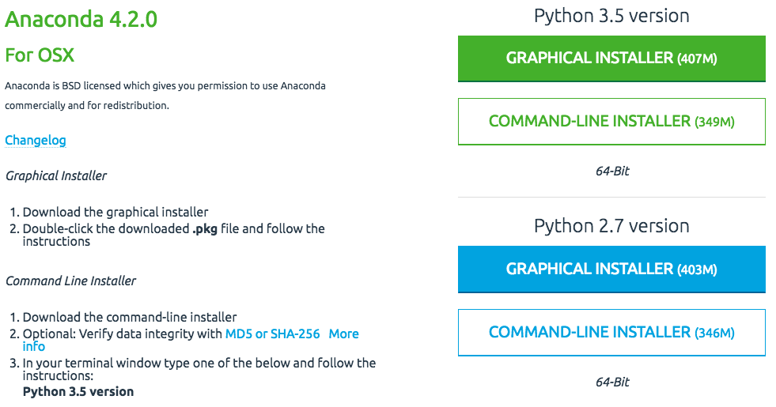
Getting Started
https://www.continuum.io/downloads
Notes:
To do this at home, you need to install Anaconda first. It installs all the programs 1`you need to run Jupyter Notebooks. I use the 2.7 version, but we can also easily create a python 3.5 environment from the Launcher App.
It should be installed on the Mac side of every computer in the lab. If you go to the HD you should see a folder for “Anaconda” and an application called Launcher.

Slide 28
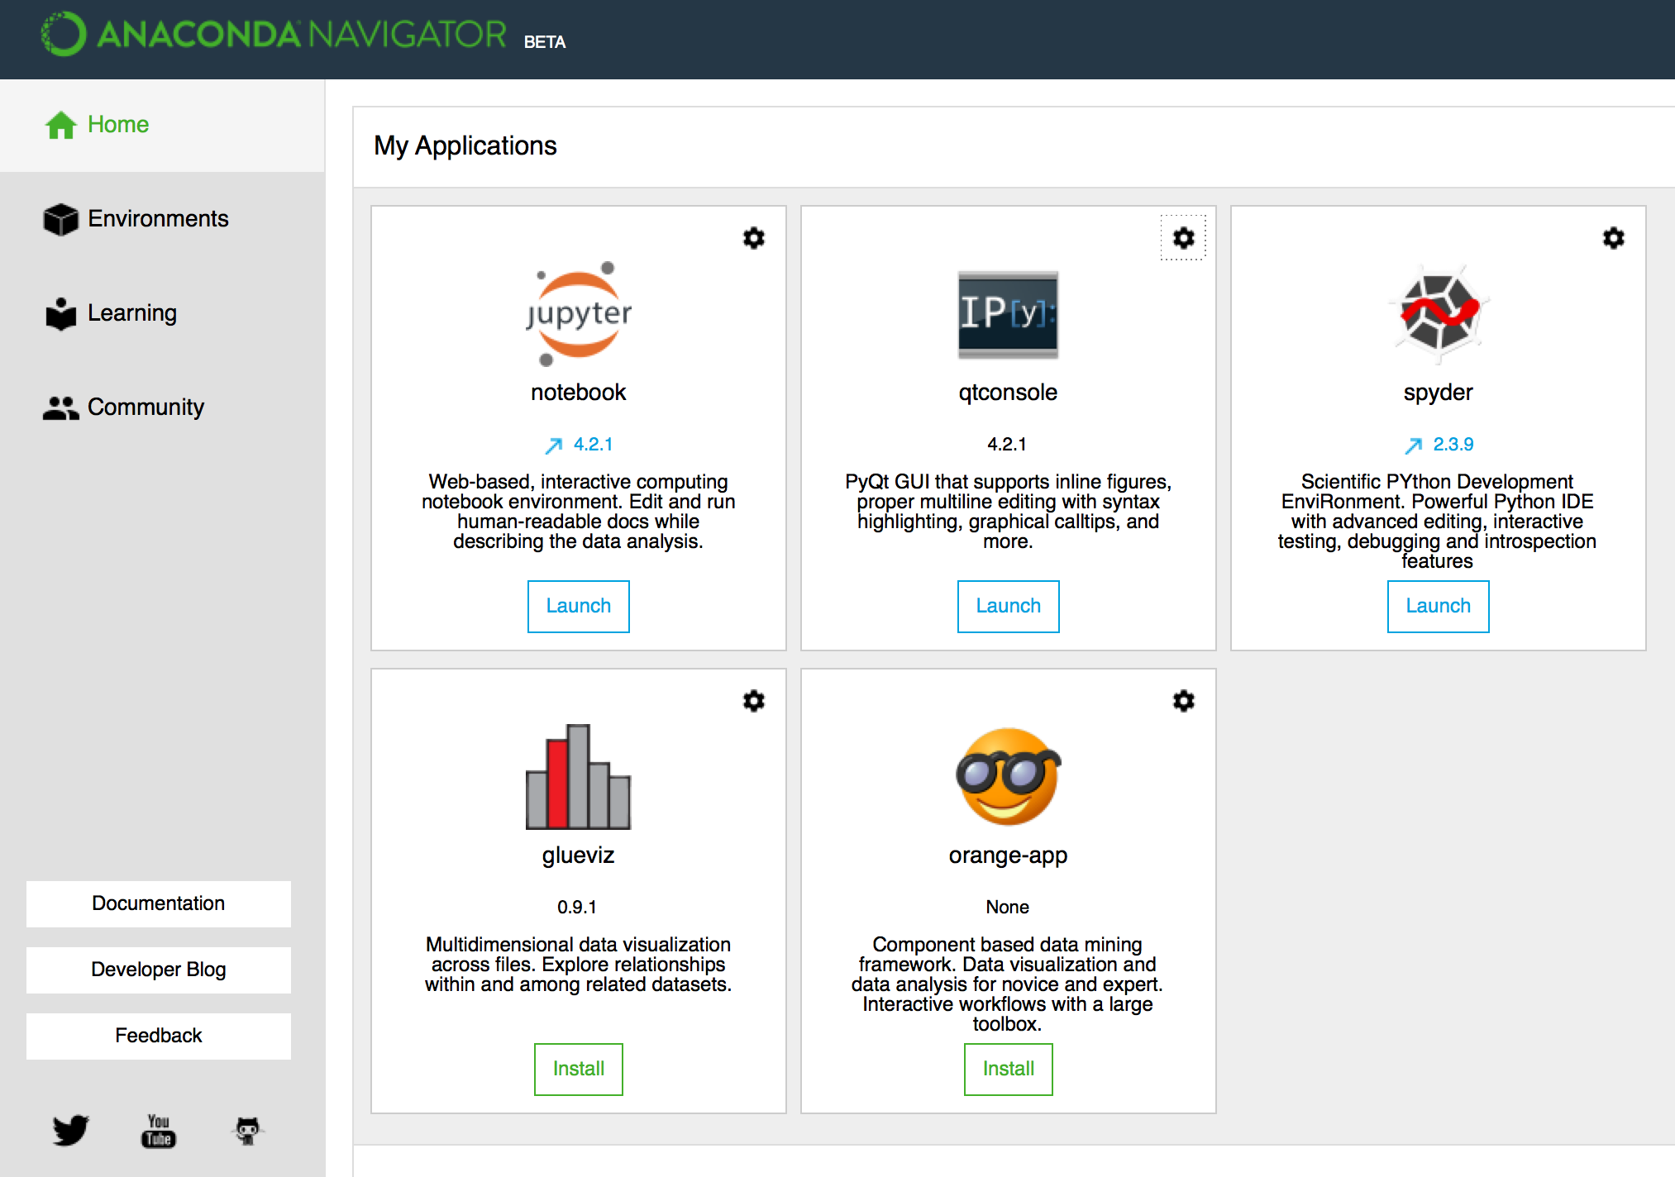
Notes:
Navigator is used to boot up the ipython notebook (now called Jupyter notebook).
The NB is interesting because although you’re look at it in your browser, the code is actually being executed by a different program (which could even be on another server or elsewhere on the internet entirely).

Slide 29
Questions?

